Slide 1
Housing Market Analysis(EDA)

Slide 2
Tasks
Loading the Data
Cleaning the Data
Univariate Analysis
Feature Engineering
5. Multivariate Analysis
6. Feature Engineering and Size Impact
7. Market Trends and Historical Pricing:
8. Customer Preferences and Amenities

Slide 3
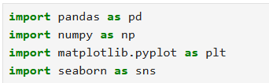
Import and Loading the Data
Pandas : Core library for data cleaning and manipulation
NumPy : Used for detecting numeric columns and computing median for missing-value filling
Matplotlib : It controls figure size, labels, titles, and rendering of plots.
seaborn :Seaborn is built on top of Matplotlib and is used for statistical data visualization.

Slide 4
Import and Loading the Data
What this line does
It tells Seaborn to use a white background with grid lines for all plots.
It is especially useful in:
Histograms
Scatter plots
Line plots
What this line does
This loads your housing dataset from your computer into Python.
pd.read_csv() reads a CSV file
The result is stored in df, a Pandas DataFrame (table)

Slide 5

Cleaning the Data
df.shape
shows the size of the dataset in the format
Why this is important
How much data we have
How many variables we are working with
This helps in:
Choosing algorithms
Estimating computation
Understanding data complexity
print(df.head())
What this line does
It prints the first 5 rows of the dataset.
Why this is used
It helps to:
See how the data looks
Check column names
Verify data loaded correctly
Spot obvious errors (missing, wrong values)
print(df.info())
It prints
Column names
Data types (int, float, object, etc.)
Count of non-null values
Memory usage
Why this is important
Which columns have missing values
Which columns are numeric or categorical
What cleaning or conversion is needed

Slide 6

Cleaning the Data
df.select_dtypes(include='object')
Selects all columns that contain text or categorical data
.columns
Extracts only the column names from the selected categorical columns
cat_cols
Stores the names of all categorical columns so they can be processed together
for col in cat_cols:
Loops through each categorical column one by one
df[col].fillna("None")
Replaces missing values (NaN) with the word "None"
This keeps the dataset consistent and prevents errors during analysis or modeling

Slide 7

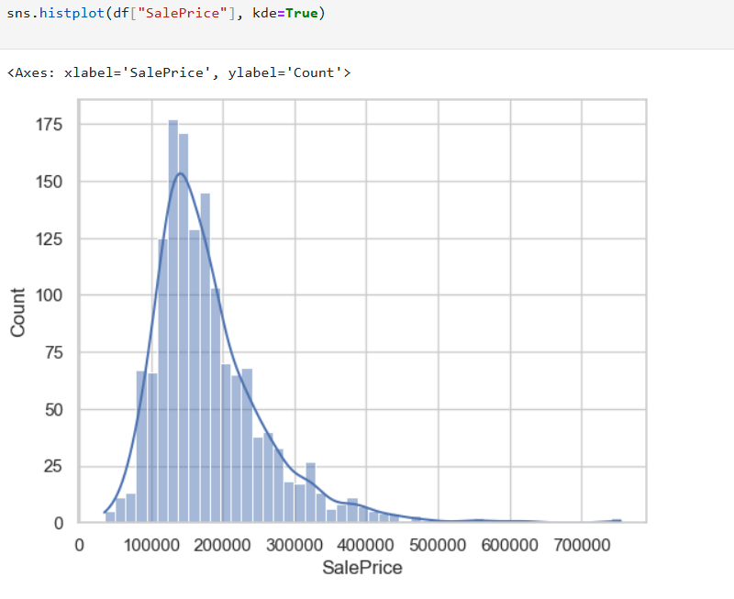
Univariate Analysis

Slide 8
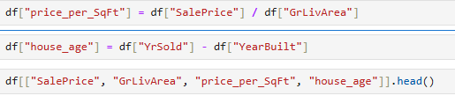
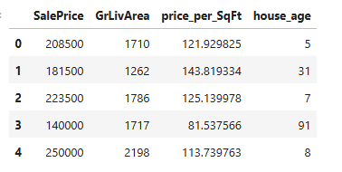
Feature Engineering
Price per Square Foot & House Age

Slide 9
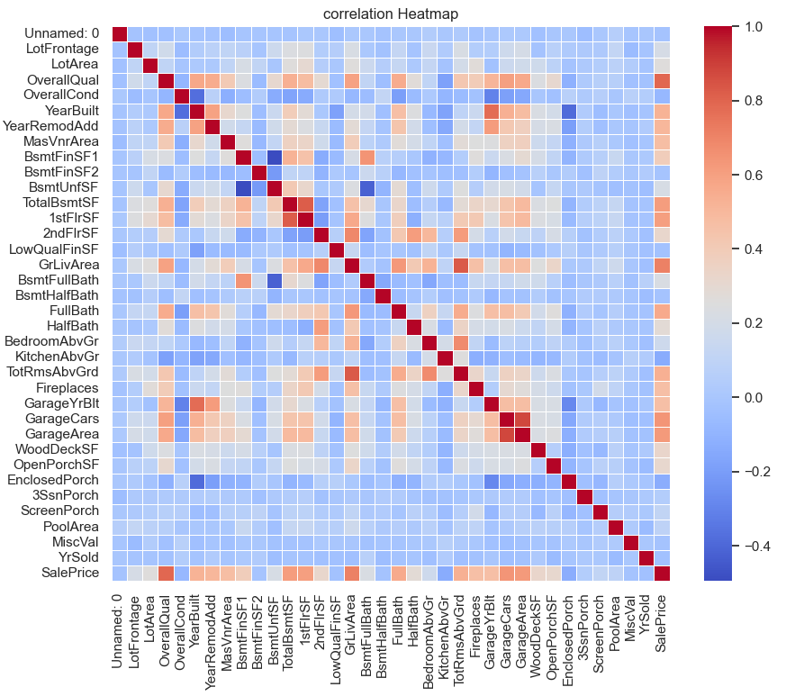
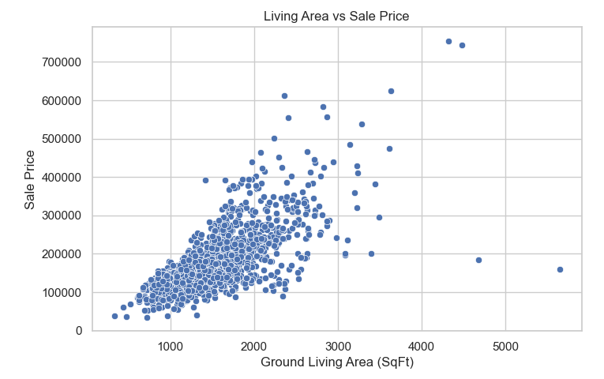
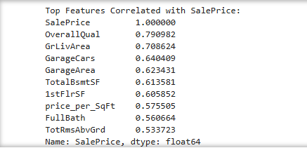
Living Area vs Sale Price (Scatter Plot)
Multivariate Analysis
Correlation Matrix & Heatmap
Top Features Correlated with Sale Price

Slide 10
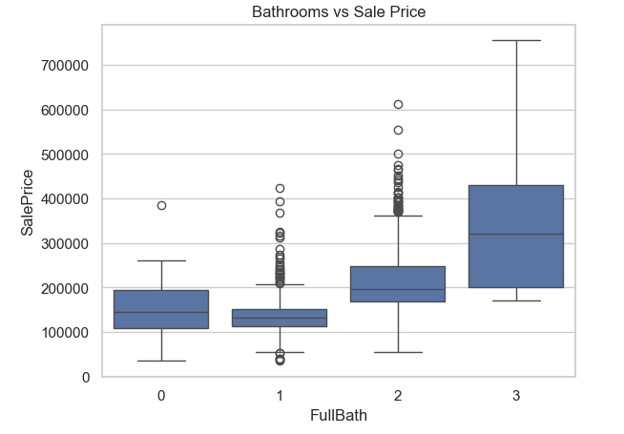
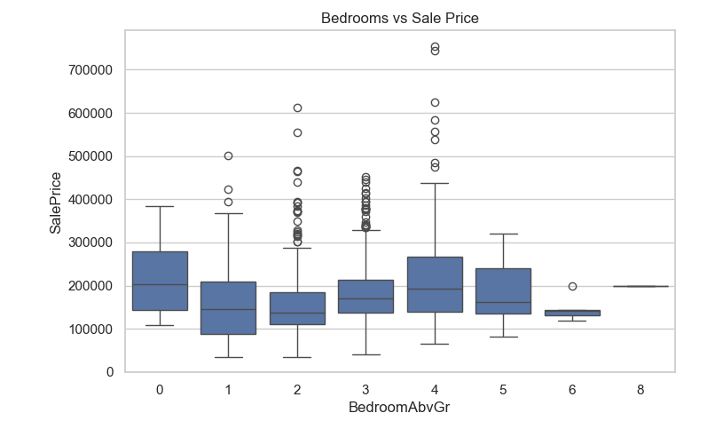
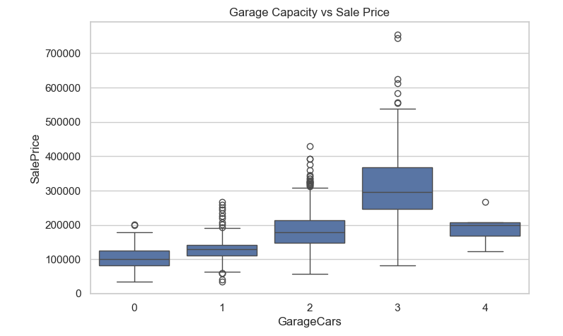
Feature Engineering and Size Impact
Bedrooms vs Sale Price
Bathrooms vs Sale Price
Garage Cars vs Sale Price

Slide 11
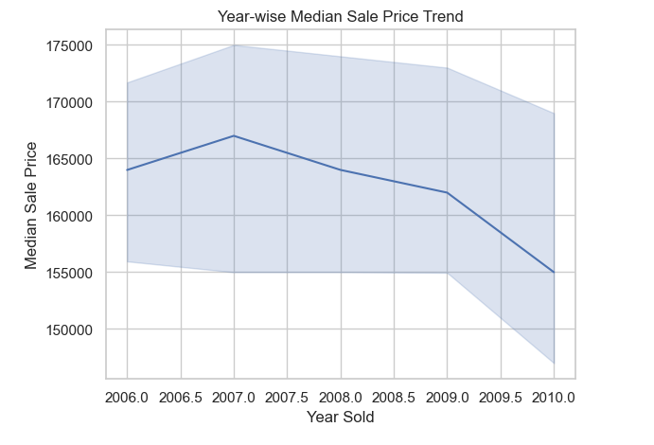
Market Trends and Historical Pricing

Slide 12
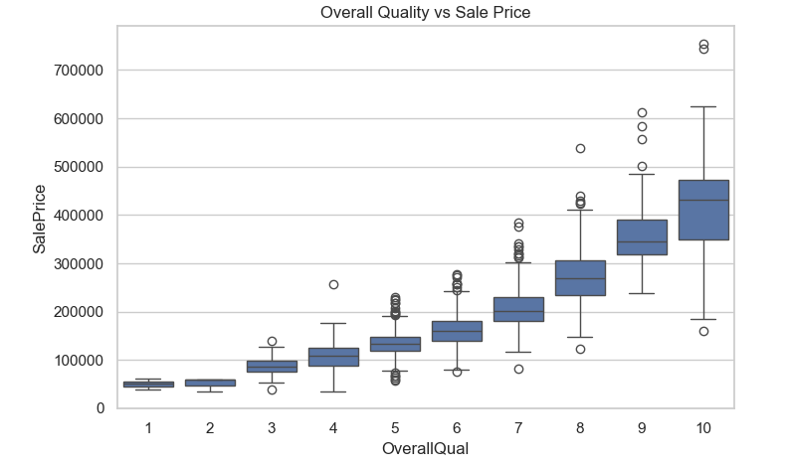
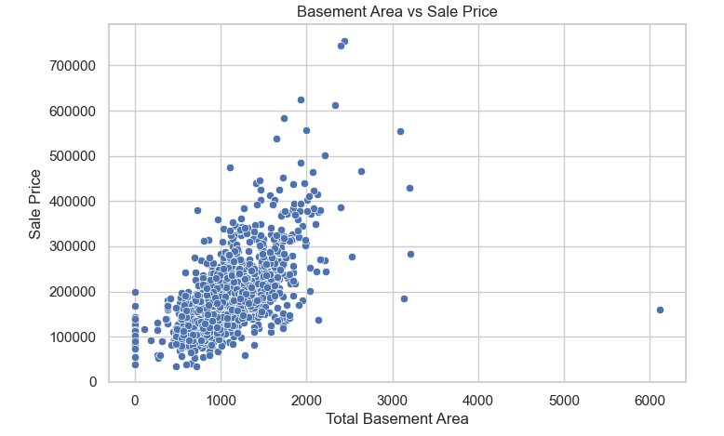
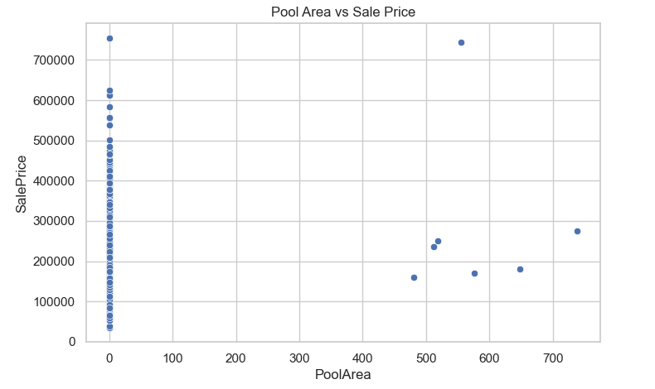
Customer Preferences and Amenities
Overall Quality vs Sale Price
Basement Area vs Sale Price
Pool Area vs Sale Price (if available)

Slide 13
Thank you

